Slide 1

Презентация к уроку английского языка в 4 классе
по теме «Past Simple»
Выполнена учителем английского языка МБОУ лицей № 4
Фроловой Анной Васильевной

Slide 2
Now I know
Listening
Vocabulary
Reading and writing
Grammar

Slide 3






WB ex 1 p 56
ex 2 p 118

Slide 4
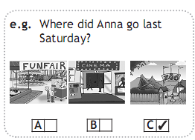
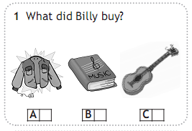
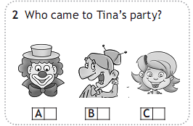
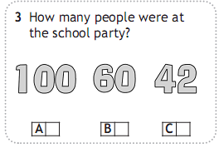
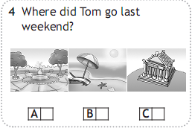
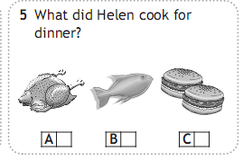


Slide 5

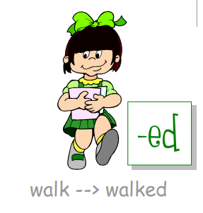
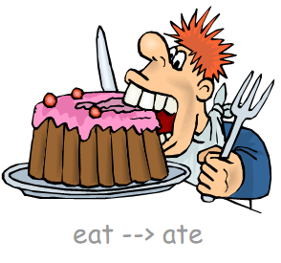
Past Simple
regular
irregular
V + (e)d
V меняет форму

Slide 6

watch
see
collect
cry
swim
play
write
paint
walk
get
look
take
dance
sleep
regular
irregular

Slide 7









Let’s play puzzles
say
go
take
give
took
had
saw
won
see
gave
have
win
drank
come
come
went
came
bought
drink
said
buy

Slide 8
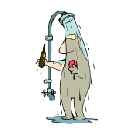
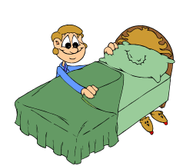
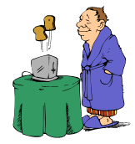


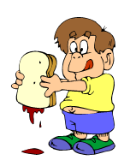
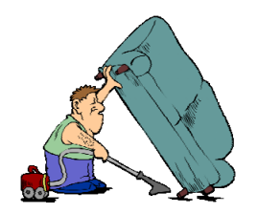





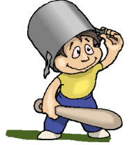

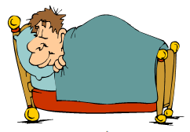
What did Larry do last Sunday?
In the morning
In the afternoon
In the evening

Slide 9

Dear Jim,
Last month I (be) was at Chatterplace. I (have) ___ a good time there. I (live) ___ in a small but nice room. When it (be) ___ fine and warm, I (go) ___ for a walk and (play) ___ tennis.
I (help) ____ Miss Chatter to feed the animals. I (learn) ____ to ride a horse. When it (be) ___ sunny, I (swim) ___ in a nearby river. I (see) ___ a lot of beautiful places. I (visit) ____ Tony and (listen) ____ to his new fairy tale.
I (like)____ my holidays. I’ll come back to Chatterplace next year. Would you like to go with me?
Please write back. Yours, Ben.
had
lived
was
went
played
helped
learned
was
swam
saw
visited
listened
liked

Slide 10
SB ex 3, 5 p 119

Slide 11





Good Bye!

