Slide 1
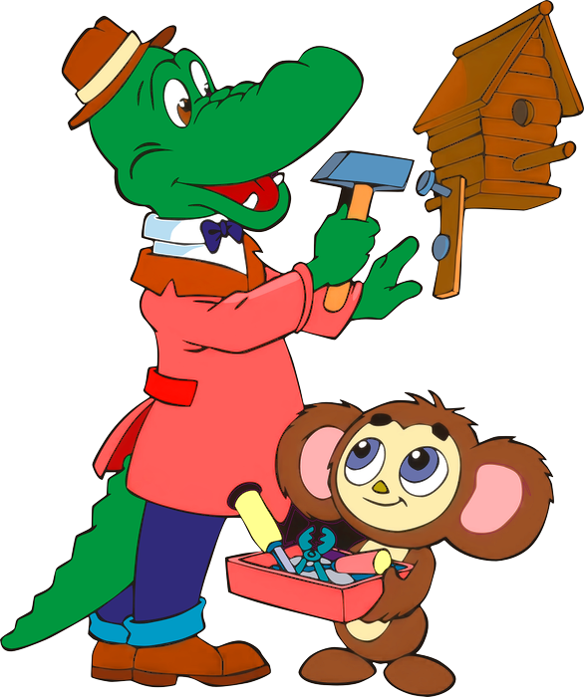
Tell the tale

Slide 2
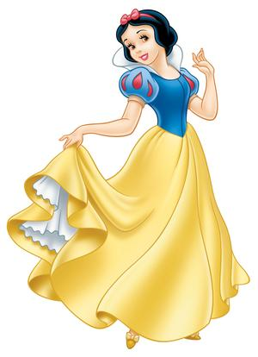
Good morning!
What date is it today? Today is the … of …

Slide 3
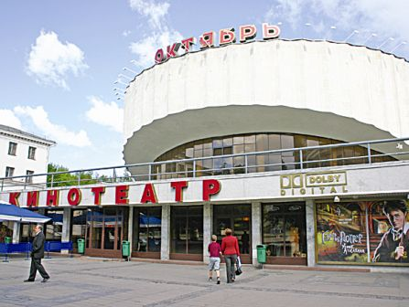
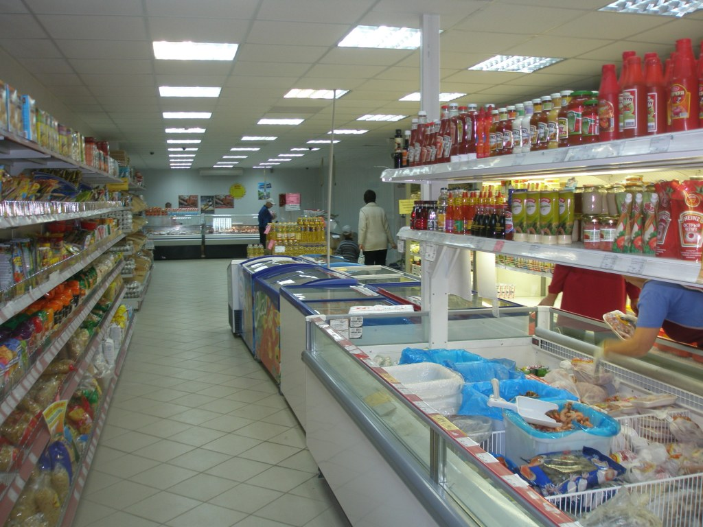
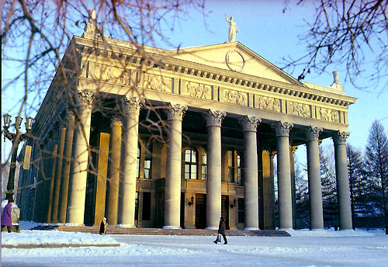


Where were you yesterday?
I
was
at
the

Slide 4

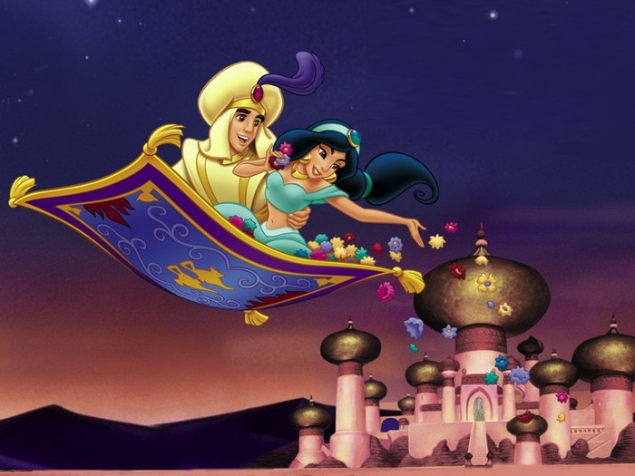
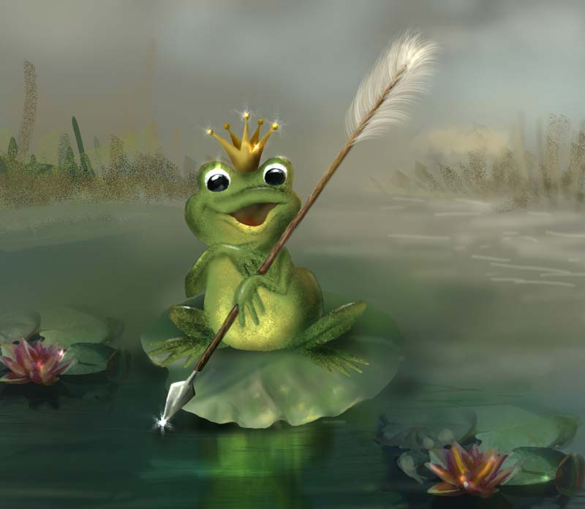
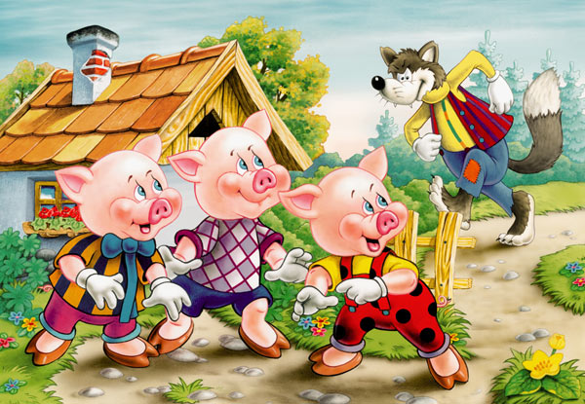
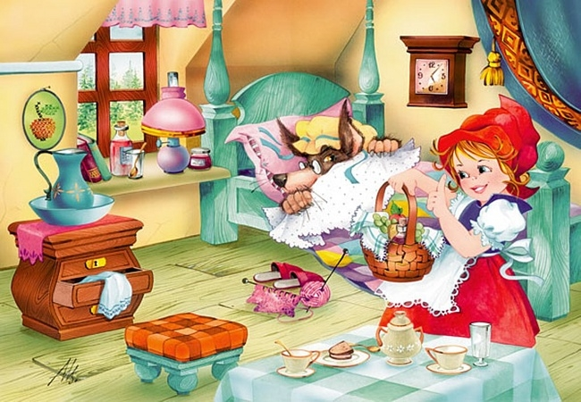
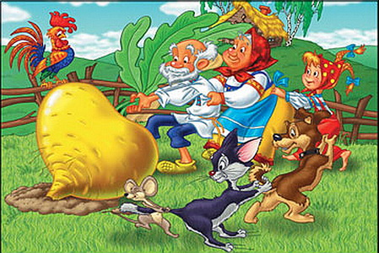
Do you like the tales?

Slide 5
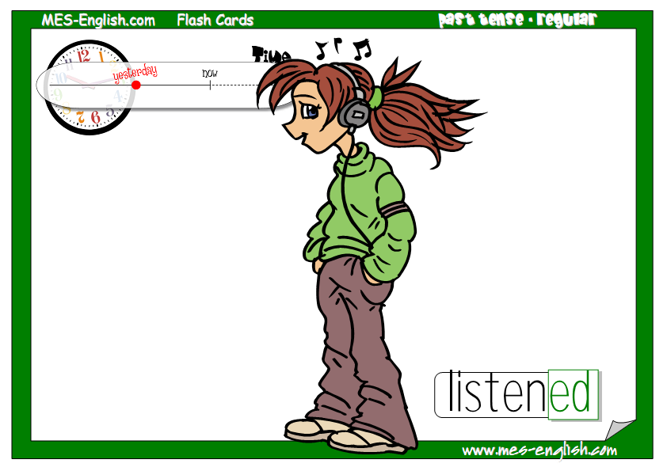
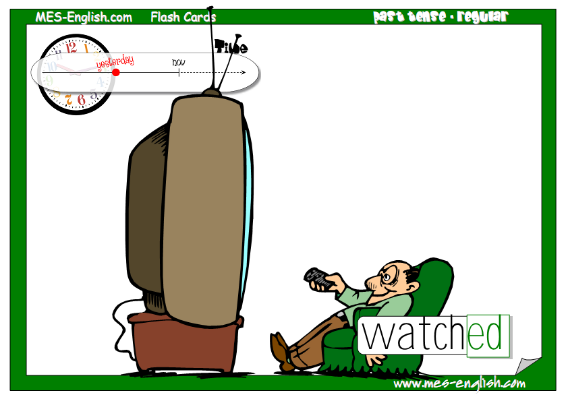
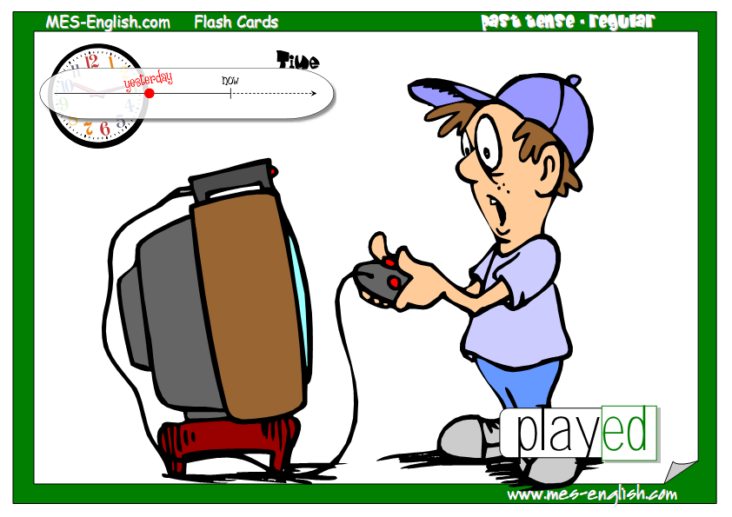
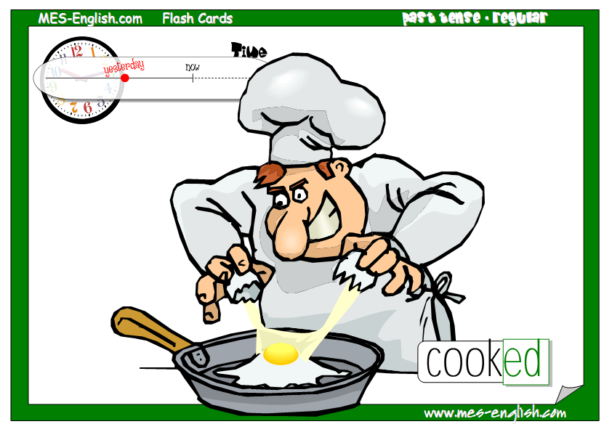
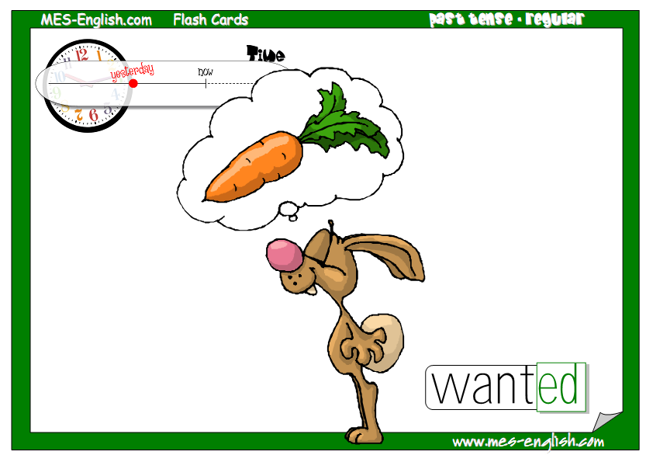

Slide 6
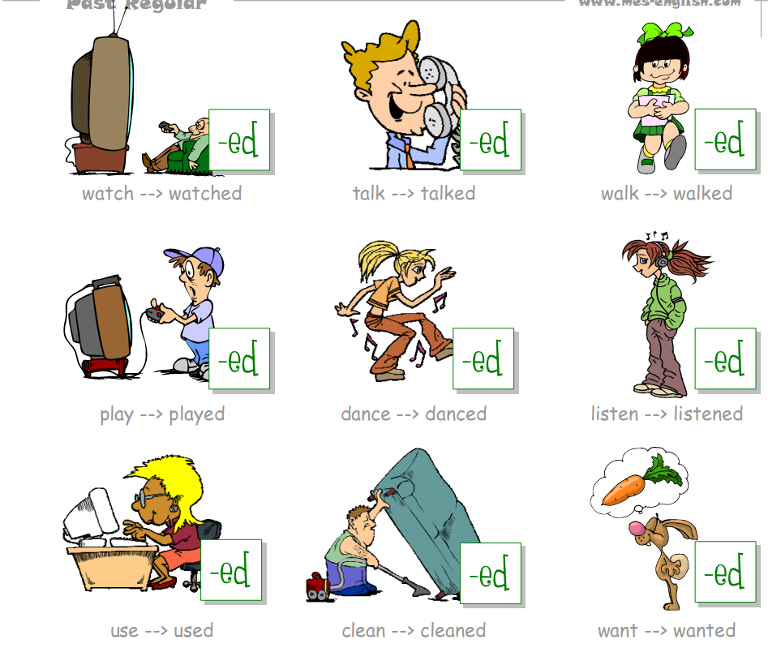

Slide 7

Open your books p.90 ex.1
fast hare
slow tortoise
race
jumped
rest
pass
winner
быстрый заяц
медленная черепаха
гонка
прыгал
отдохнуть
проходить
победитель

Slide 9
Match
The hare always laughed at the tortoise
When they started the race,
It was a very hot day
A few hours later,
The tortoise was the winner and
and the hare was very hot
the hare learned his lesson that day
because he was so slow
the hare jumped forward
the tortoise passed the sleeping hare

Slide 10
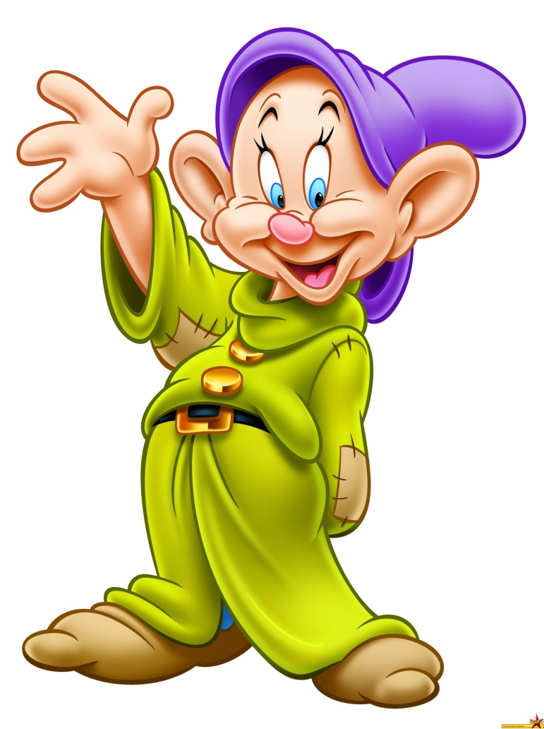
Homework:
SB ex.1 p. 90
WB ex. 1,2 p.46
Good bye!

